Slide 1
Transportation Problem using Vogul’s Approximation Method

Slide 2
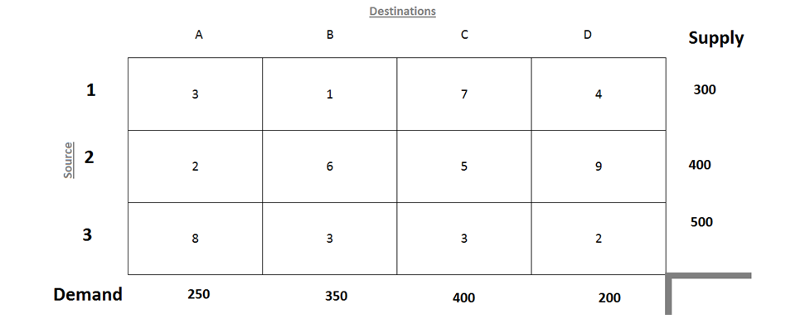

Slide 3
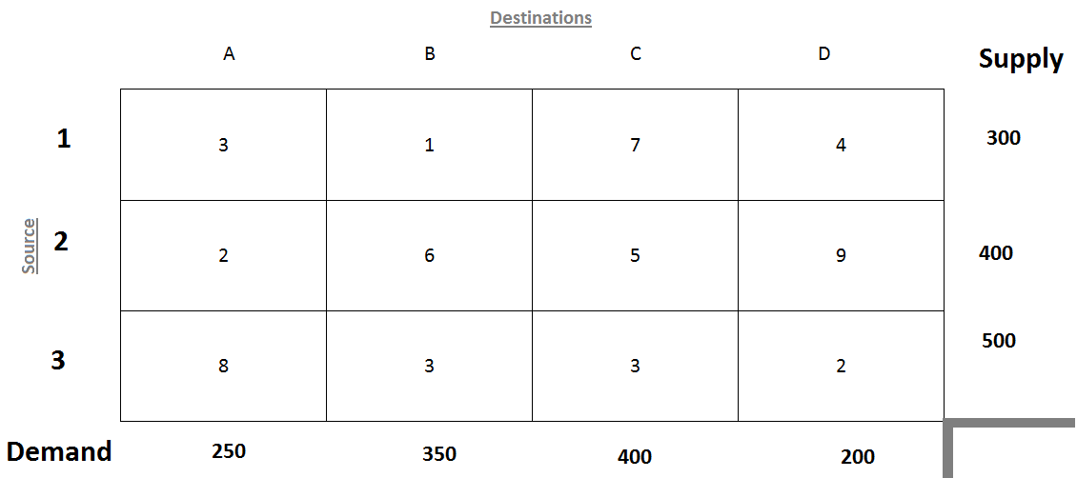

Slide 4
Check if the given transportation problem is balanced or not,
by calculating total demand and total supply capacity,
and compare with each other.

Slide 5
300+400+500=1200
250+350+400+200 = 1200

Slide 6
Here, total demand = total supply = 1200
Since Demand and Supply are equal, this is a balanced transportation problem.

Slide 7
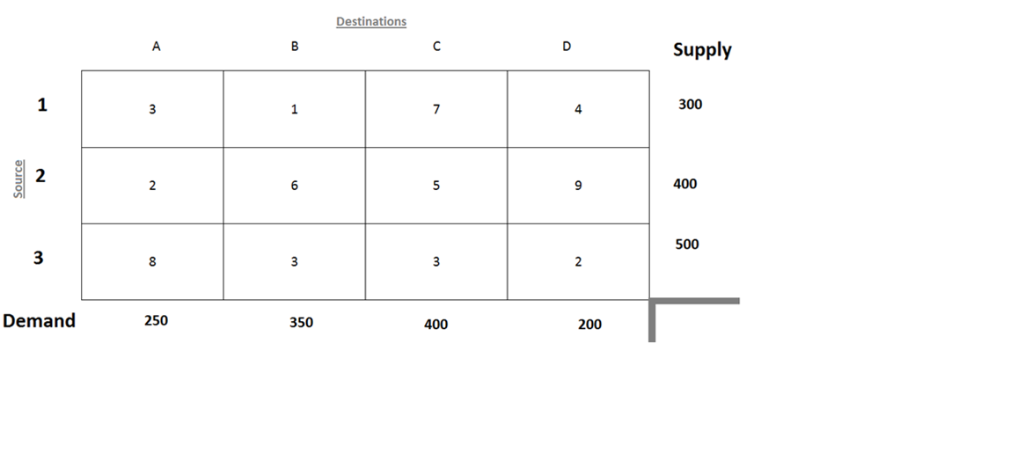
Row Difference
2
3
1
Column Difference

Slide 8
Row Difference
2
3
1
1
2
2
2
Column Difference

Slide 9

Row Difference
2
150
3
1
0
1
2
2
2
Column Difference

Slide 10
Row Difference
2
3
150
3
1
1
1
0
1
2
2
2
Column Difference

Slide 11
Row Difference
2
3
150
3
1
1
1
0
1
2
2
2
Column Difference
2
2
2

Slide 12

Row Difference
0
2
3
150
3
1
1
1
0
50
1
2
2
2
Column Difference
2
2
2

Slide 13
Row Difference
0
2
3
150
3
1
1
1
1
1
0
50
1
2
2
2
Column Difference
2
2
2

Slide 14
Row Difference
0
2
3
150
3
1
1
1
1
1
0
50
1
2
2
2
Column Difference
2
2
2
3
2
7

Slide 15
Row Difference
0
2
3
150
3
1
1
1
1
1
300
0
50
0
1
2
2
2
Column Difference
2
2
2
3
2
7

Slide 16
Row Difference
0
2
3
150
3
1
1
1
1
1
1
0
300
0
50
0
1
2
2
2
Column Difference
2
2
2
3
2
7

Slide 17
Row Difference
0
2
3
150
3
1
1
1
1
1
1
0
300
0
50
0
1
2
2
2
Column Difference
2
2
2
3
2
7
3
2

Slide 18


Row Difference
0
2
3
150
3
1
1
1
1
1
1
300
250
0
50
0
0
1
2
2
2
Column Difference
2
2
2
3
2
7
3
2

Slide 19
Row Difference
0
2
3
150
3
1
1
1
1
1
1
300
250
0
0
50
150
0
0
1
2
2
2
Column Difference
2
2
2
3
2
7
3
2

Slide 20

Row Difference
0
2
3
0
150
3
1
1
1
1
1
1
300
250
0
0
50
150
0
0
0
1
2
2
2
Column Difference
2
2
2
3
2
7
3
2

Slide 21
300*1
+150*5
+50*3
+250*3
=2850
+ 250*2
+200*2
Row Difference
0
2
3
0
150
3
1
1
1
1
1
1
300
250
0
0
50
150
0
0
0
1
2
2
2
Column Difference
2
2
2
3
2
7
3
2

Slide 23
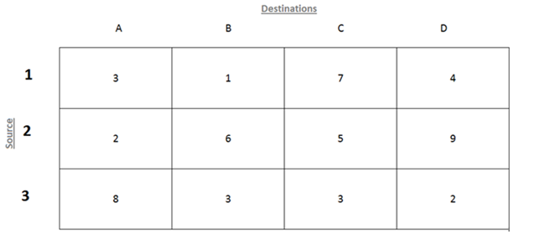
U₁
U₂
U₃
V₁
V₂
V₃
V₄

Slide 24
Let U₁ = 0
U₂
U₃
V₁
V₂
V₃
V₄
P_{ij} = U_{i} + V_{j}
P₁₂ = U₁ + V₂
1 = 0 + V₂
V₂ = 1
P₂₁ = U₂ + V₁
2 = 4 + V₁
V₁ = -2
P₂₃ = U₂ + V₃
5 = U₂ + 1
U₂ = 4
P₃₂ = U₃ + V₂
3 = U₃ + 1
U₃ = 2
P₃₃ = U₃ + V₃
3 = 2 + V₃
V₃ = 1
P₃₄ = U₃ + V₄
2 = 2 + V₄
V₄ = 0

Slide 25
U₁ = 0
U₂ = 4
U₃ = 2
V₁ = -2
V₂ = 1
V₃ = 1
V₄ = 0
P_{ij} = U_{i} + V_{j}
P₁₂ = U₁ + V₂
1 = 0 + V₂
V₂ = 1
P₂₁ = U₂ + V₁
2 = 4 + V₁
V₁ = -2
P₂₃ = U₂ + V₃
5 = U₂ + 1
U₂ = 4
P₃₂ = U₃ + V₂
3 = U₃ + 1
U₃ = 2
P₃₃ = U₃ + V₃
3 = 2 + V₃
V₃ = 1
P₃₄ = U₃ + V₄
2 = 2 + V₄
V₄ = 0

Slide 27
U₁ = 0
U₂ = 4
U₃ = 2
V₁ = -2
V₂ = 1
V₃ = 1
V₄ = 0
Δ_{ij} = P_{ij} – U_{i} - V_{j}
Δ₁₁ = P₁₁ – U₁ – V₁
Δ₁₁ = 3 – 0 – (-2) = 5
Δ₁₁ = 5
Δ₁₃ = P₁₃ – U₁ – V₃
Δ₁₃ = 7 – 0 – 1 = 6
Δ₁₃ = 6
Δ₁₄ = P₁₄ – U₁ – V₄
Δ₁₄ = 4 – 0 – 0 = 4
Δ₁₄ = 4
Δ₂₂ = P₂₂ – U₂ – V₂
Δ₂₂ = 6 – 4 – 1 = 1
Δ₂₂ = 1
Δ₂₄ = P₂₄ – U₂ – V₄
Δ₂₄ = 9 – 4 – 0 = 5
Δ₂₄ = 5
Δ₃₁ = P₃₁ – U₃ – V₁
Δ₃₁ = 8 – 2 – (-2) = 8
Δ₃₁ = 8

